Slide 1
Chapter 5: Process Scheduling
March, 2024

Slide 2
Chapter 5: Process Scheduling
Basic Concepts
When does scheduling happen?
Scheduling Criteria
Scheduling Algorithms

Slide 3
Objectives
To introduce CPU scheduling, which is the basis for multi-programmed operating systems
To discuss evaluation criteria for selecting a CPU-scheduling algorithm for a particular system
To describe various CPU-scheduling algorithms

Slide 4
Basic Concepts
Process scheduling
Thread scheduling
CPU scheduling
Core scheduling

Slide 5
Basic Concepts
Maximum CPU utilization obtained with multiprogramming
CPU–I/O Burst Cycle – Process execution consists of a cycle of CPU execution and I/O wait
CPU burst followed by I/O burst
CPU burst distribution is of main concern
Notes:
CPU执行和I/O执行交替，CPU在等待时空闲，浪费时间

Slide 6
CPU/IO Bound Processes
CPU密集型和I/O密集型
Notes:
CPU密集型和I/O密集型

Slide 7
Dispatcher（调度程序）
Scheduler
Select
Dispatch
Dispatcher functions：
switching context
switching to user mode
jumping to the proper location in the user program to restart that program（跳转到程序的合适位置重启）
执行进程切换时的上下文save和load等工作
Notes:
执行进程切换的上下文保存等工作

Slide 8
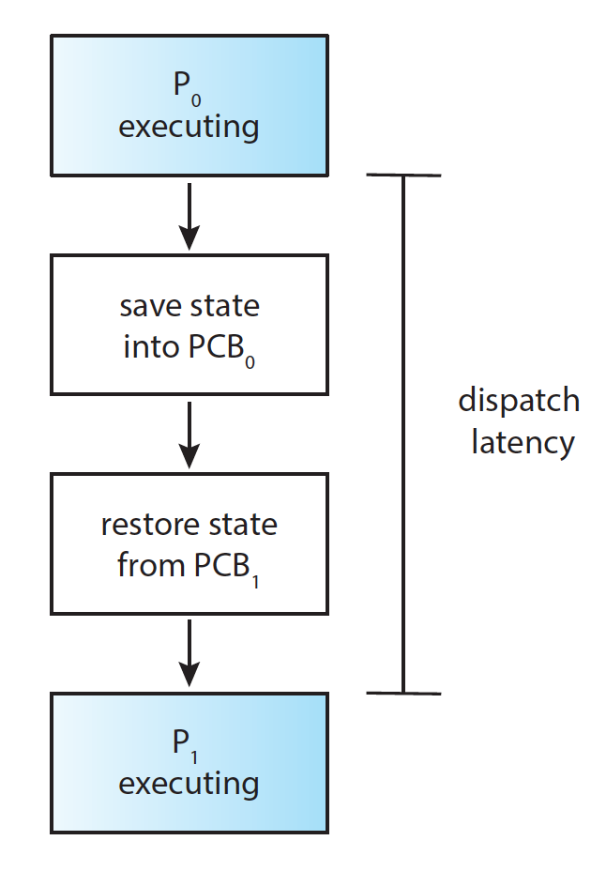
Dispatcher Latency（调度延迟）
Dispatch latency – time it takes for the dispatcher to stop one process and start another running

Slide 9
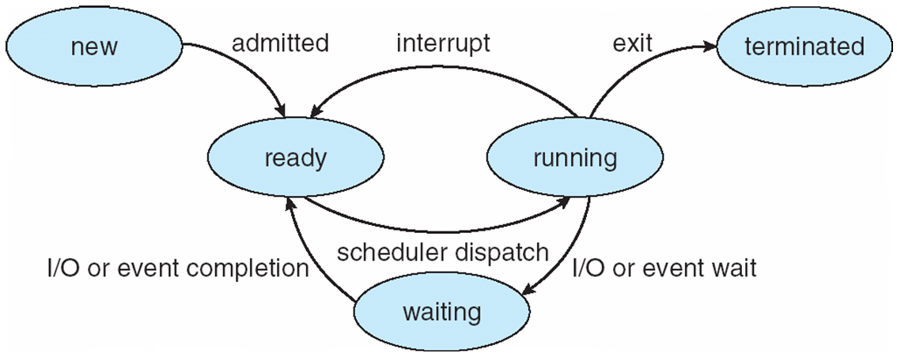
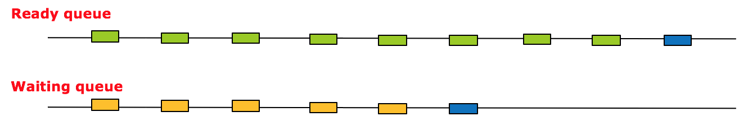
When scheduling happens
1
6
2&3
5
4
CPU
(head)

Slide 10
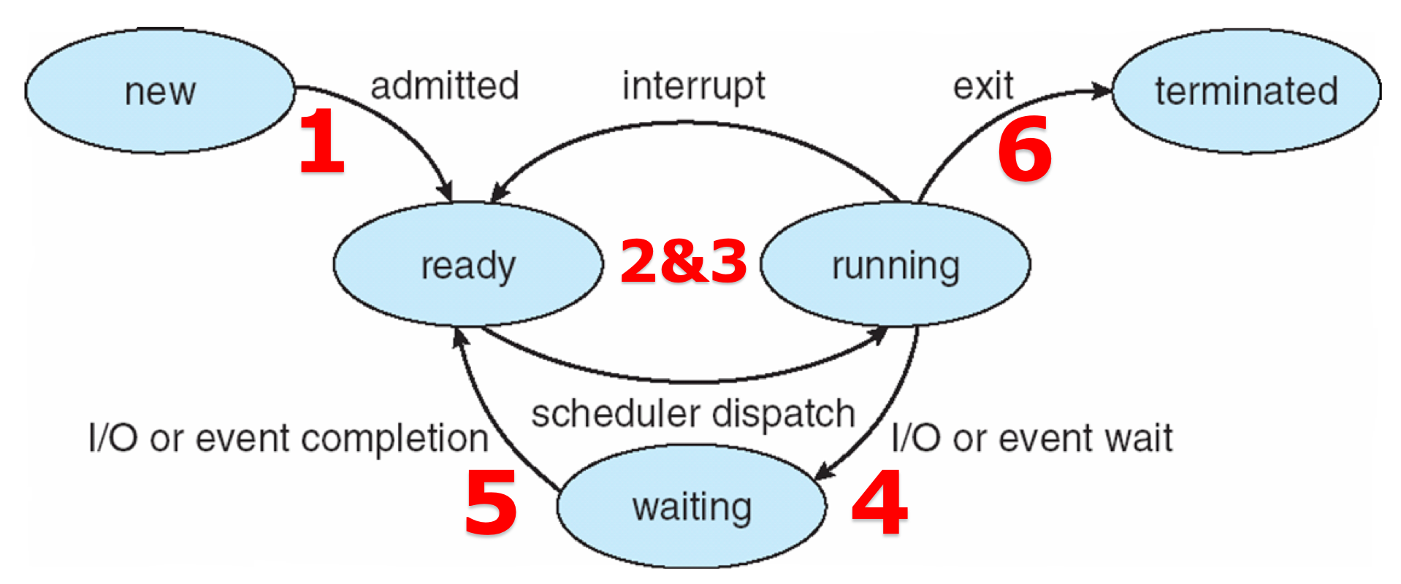
OS Kernel Scheduling Points
System call
fork(1), exit(6), read(4)
Interrupt
timer(2), I/O(5)
Notes:
4：发出系统调用read()请求io设备，trap in kernel。如果I/O设备还没有在buffer中准备好数据（例如，数据还在从磁盘读取的过程中，或者网络数据还没有到达），操作系统会将发起 read 请求的进程置于阻塞状态，并将其放入等待队列（通常与特定的I/O设备相关联）

Slide 11
Preemptive（抢占） or Non-preemptive
Scheduling under 4 and 6 is non-preemptive
preemptive
Notes:
vmstat 1 (1秒间隔，持续执行)
system：
in: 每秒中断数，包括时钟中断。【interrupt】
cs: 每秒上下文切换数。 【count/second】
cat /proc/[pid]/status
printf() ??? (demo?)

Slide 12
Scheduling Criteria（准则）
CPU utilization（使用率） – keep the CPU as busy as possible
Throughput – number of processes that complete their execution per time unit
Turnaround time（周转时间） – amount of time to execute a particular process（进程运行完毕时间 - 进程到达时间）（including the waiting time）
Waiting time – amount of time a process has been waiting in the system （进程运行完毕时间 - 进程到达时间 – 进程真正在运行的用时）
Response time – amount of time it takes from when a request was submitted until the first response is produced（从提交请求到第一响应的时间）
Notes:
要会计算average turnaround time 和 average waiting time
Turnaround time = 进程运行完毕时间 - 进程到达时间
也就是总用时

Slide 13
Scheduling Algorithm Optimization Criteria
Max CPU utilization
Max throughput
Min turnaround time
Min waiting time
Min response time
Optimize
Average
Maximum/minimum
Variance

Slide 14
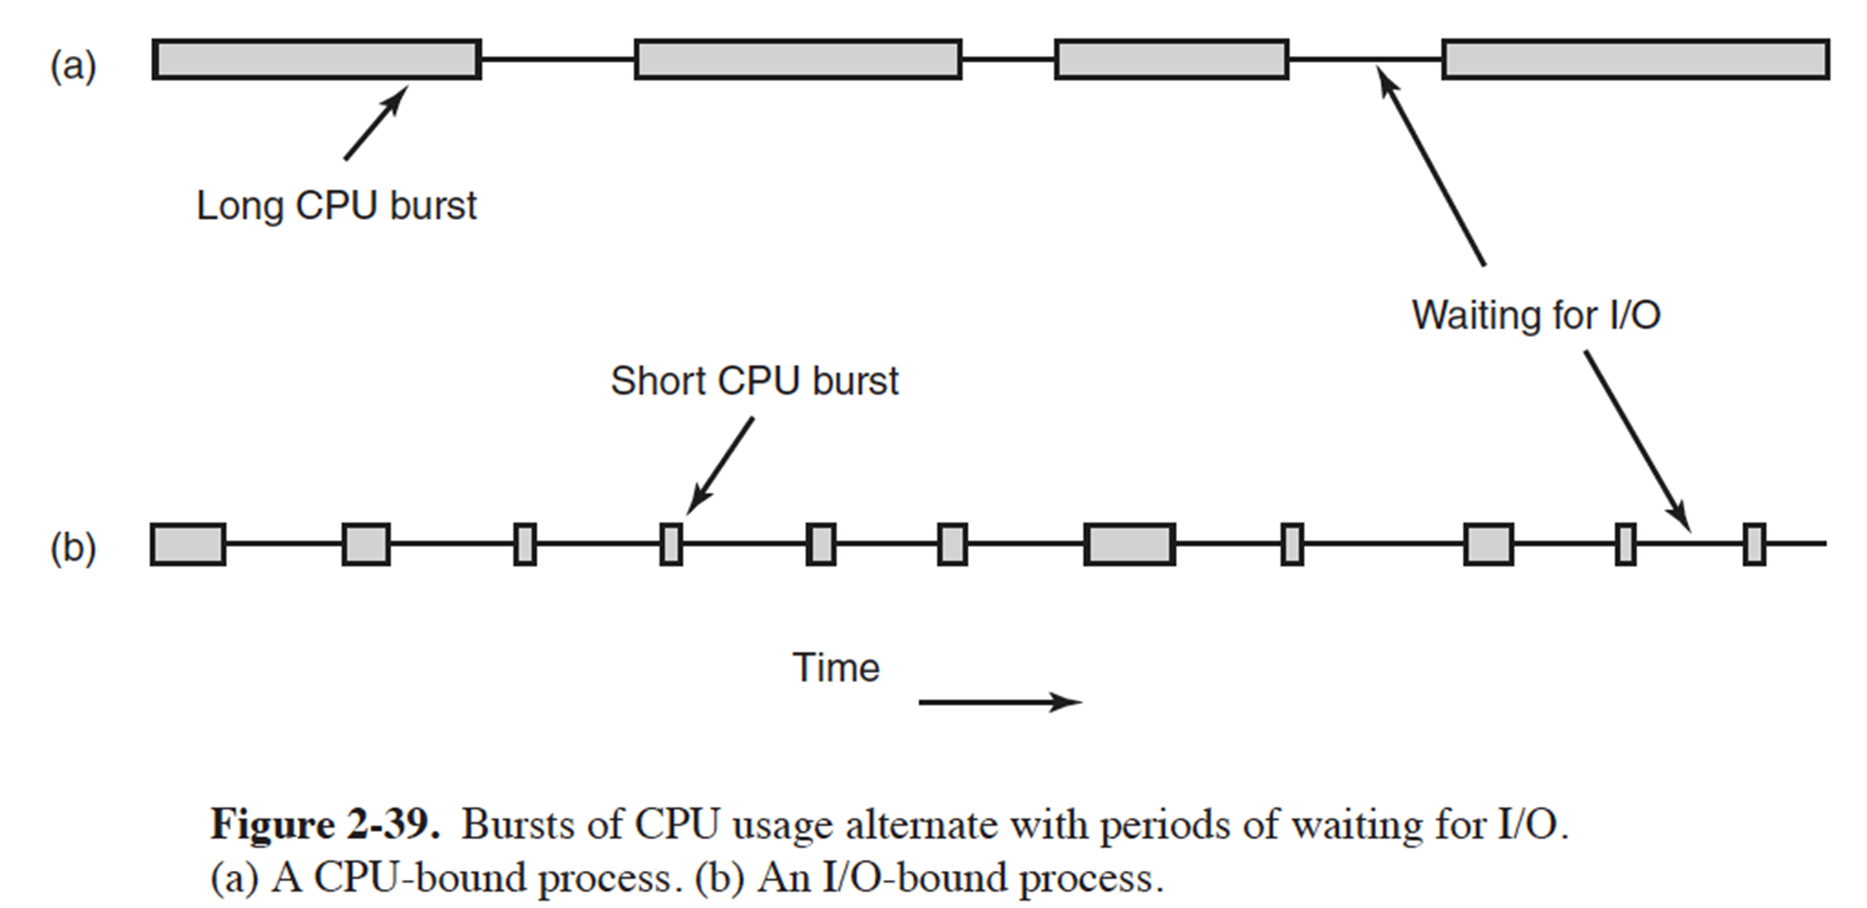
Scheduling Algorithms
One CPU burst, no I/O (treat each CPU burst as independent)
Arrive at time 0
Average waiting time
Algorithms
FCFS (first come first served)
SJF (shortest job first), SRTF (shortest remaining time first)
PRI (priority)
RR (round robin)
MQ (multi-level queue)
RT (real time): RM (rate monotonic), EDF (earliest deadline first)

Slide 15
First-Come, First-Served (FCFS) Scheduling
Suppose that the processes arrive in the order: P₁ , P₂ , P₃
The Gantt Chart for the schedule is:
Waiting time for P₁ = 0; P₂ = 24; P₃ = 27
Average waiting time: (0 + 24 + 27)/3 = 17

Slide 16
FCFS Scheduling (Cont.)
Suppose that the processes arrive in the order:
P₂ , P₃ , P₁
The Gantt chart for the schedule is:
Waiting time for P₁ = 6; P₂ = 0; P₃ = 3
Average waiting time: (6 + 0 + 3)/3 = 3
Much better than previous case

Slide 17
FCFS Scheduling (Cont.)
Convoy effect - short process behind long process
Consider one CPU-bound and many I/O-bound processes
Notes:
护航效应
对交互式任务不友好
动态情况下：CPU密集型长时间占用CPU，期间所有的IO密集型都处理完IO并移到ready queue，CPU-bound发生IO请求释放CPU后，IO-bound们很快执行完并再次进入IO device queue，等待CPU释放IO，占用CPU（很长时间），释放CPU。IO-bound们一直在等待，这也属于convoy effect

Slide 18
Shortest-Job-First (SJF) Scheduling
Associate with each process the length of its CPU burst
Use these lengths to schedule the process with the shortest time
SJF is optimal – gives minimum average waiting time for a given set of processes
The difficulty is knowing the length of the next CPU request
Could ask the user

Slide 19
Example of SJF
Average waiting time = (3 + 16 + 9 + 0) / 4 = 7

Slide 20
Break the Assumptions
The processes do not arrive at the same time
Preemptive or non-preemptive（是否抢占，两种算法）?
抢占的SJF： shortest-remaining-time-first (SRTF)
Notes:
抢占式SJF：
Process P1 is started at time 0, since it is the only process in the queue. Process
P2 arrives at time 1. The remaining time for process P1 (7 milliseconds) is
larger than the time required by process P2 (4 milliseconds), so process P1 is
preempted, and process P2 is scheduled. The average waiting time for this
example is [(10 − 1) + (1 − 1) + (17 − 2) + (5 − 3)]/4 = 26/4 = 6.5 milliseconds.

Slide 21
Priority Scheduling: low number higher priority
A priority number (integer) is associated with each process
Notes:
The average waiting time is 8.2 milliseconds.

Slide 22
Priority Scheduling
The CPU is allocated to the process with the highest priority (smallest integer ≡ highest priority)
Preemptive or Non-preemptive(可以是抢占或非抢占)
Problem ≡ Starvation – low priority processes may never execute
Solution ≡ Aging（老化） – as time progresses increase the priority of the process
Rumor has it that when they shut down the IBM 7094 at MIT in 1973, they found a low-priority process that had been submitted in 1967 and had not yet been run.
Notes:
饥饿的现象，不公平
SJF隐式地使用了优先级

Slide 23
Round Robin (RR)
Each process gets a small unit of CPU time (time quantum / slice, q), usually 10-100 milliseconds. After this time has elapsed, the process is preempted and added to the end of the ready queue.
Timer interrupts every quantum to schedule next process

Slide 24
Example of RR with Time Quantum = 4

Slide 25
Performance of RR
Performance
Typically, higher average turnaround(与time slice有关) than SJF, but better response
q large ⇒ FCFS
q small（1ms） ⇒ q must be large with respect to context switch, otherwise overhead is too high
q usually 10ms to 100ms, context switch < 10 us
Rule of thumb: 80% of CPU bursts should be shorter than q
Notes:
并不一定time slice越大，平均周转时间越小。
对批处理计算任务不友好

Slide 26
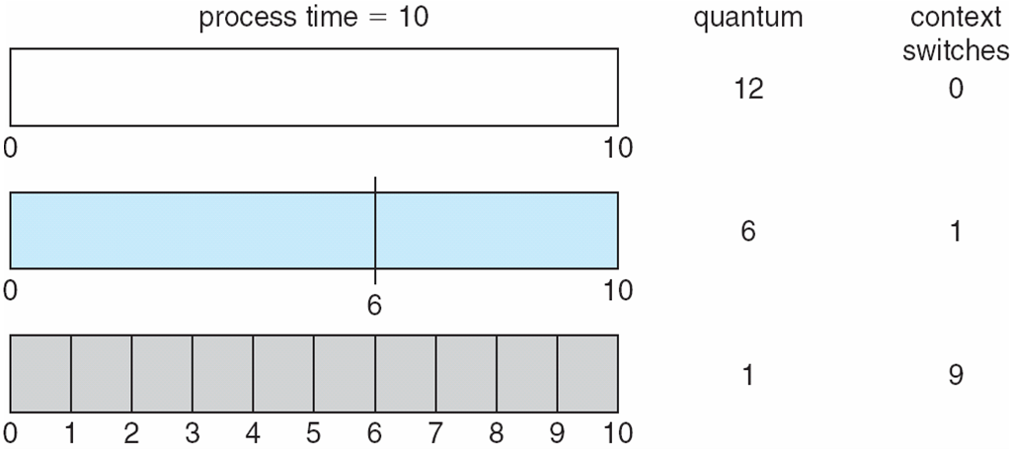
Time Quantum and Context Switch Time

Slide 27
Multilevel Queue
Ready queue is partitioned into separate queues, eg:
foreground (interactive)
background (batch)
Process permanently（永久） in a given queue
Each queue has its own scheduling algorithm:
foreground – RR
background – FCFS
Notes:
解决两个问题：
不知道每个process的cpu耗时
Round robin造成个别进程周转周期太长
多级队列可以看作优先级调度的一种实现方式

Slide 28
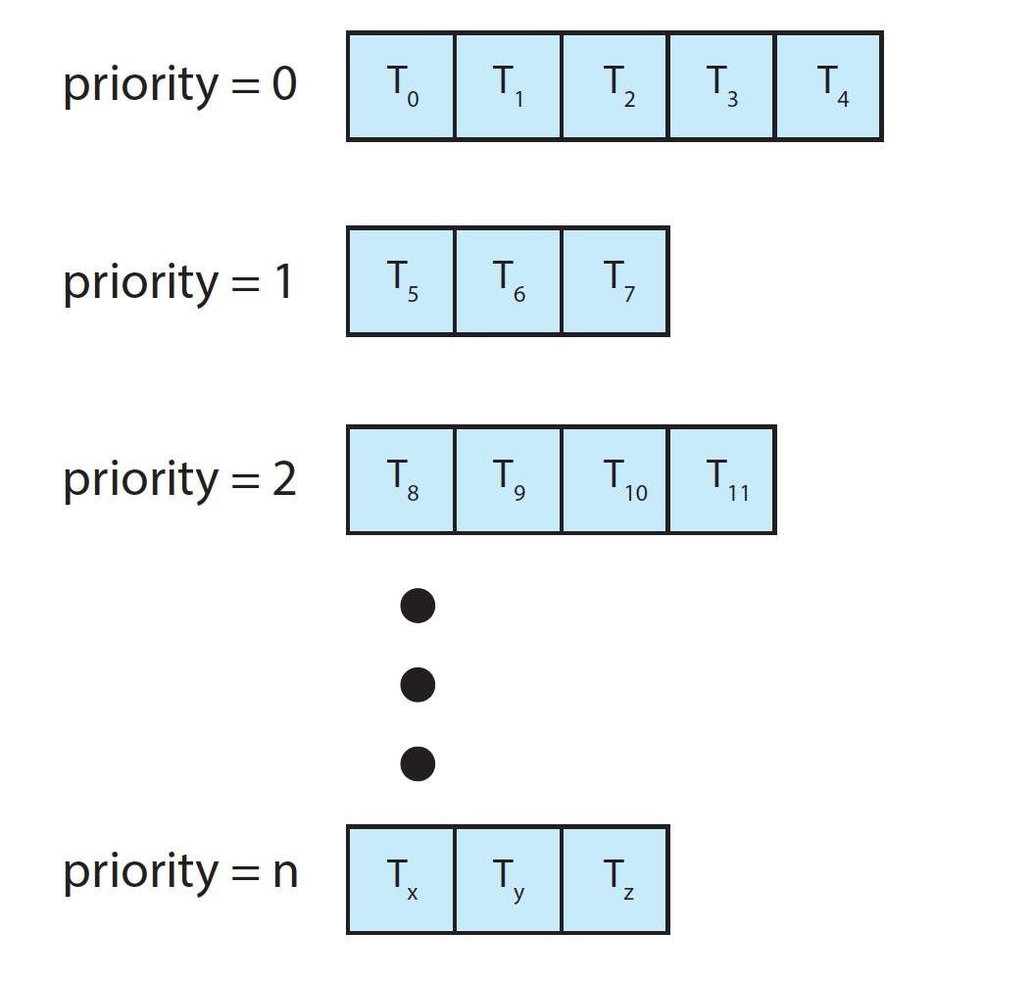
Separate Queues for Each Priority

Slide 29
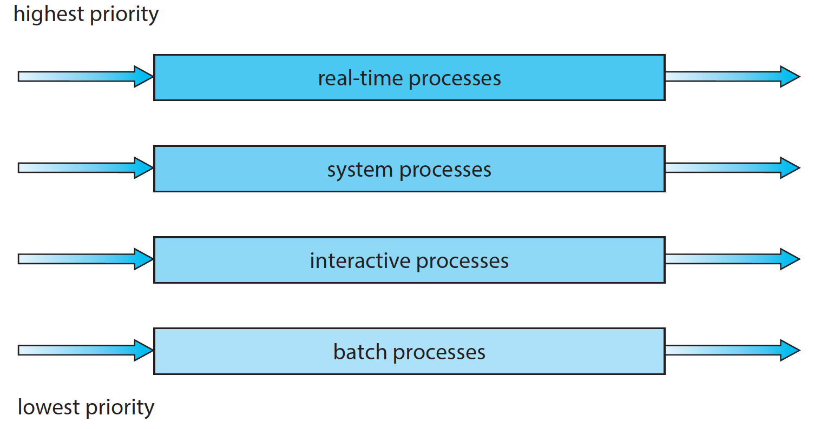
Multilevel Queue Scheduling

Slide 30
Multilevel Queue
Scheduling must be done between the queues:
Fixed priority scheduling
i.e., serve all from foreground then from background
Possibility of starvation.
Time slice
each queue gets a certain amount of CPU time which it can schedule amongst its processes; i.e.
80% to foreground in RR, 20% to background in FCFS

Slide 31
Multilevel Feedback Queue
A process can move between the various queues; aging can be implemented this way
Multilevel-feedback-queue scheduler defined by the following parameters:
number of queues
scheduling algorithms for each queue
method used to determine when to upgrade（升级） a process
method used to determine when to demote（降级） a process
method used to determine which queue a process will enter when that process needs service
Notes:
队列数量
每个队列的调度算法
何时将一个进程提到高优先级队列
何时将一个进程降到低优先级队列
进程需要执行时会进到哪个队列

Slide 32
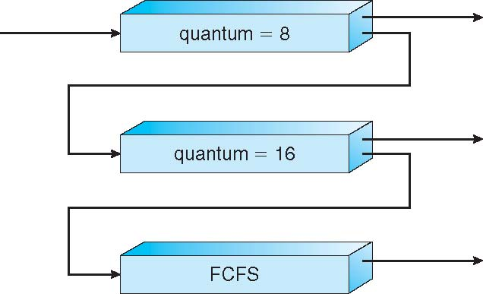
Example of Multilevel Feedback Queue
Three queues:
Q₀ – RR with time quantum 8 milliseconds
Q₁ – RR time quantum 16 milliseconds
Q₂ – FCFS
Scheduling
A new job enters queue Q₀
When it gains CPU, job receives 8 milliseconds
If it does not finish in 8 milliseconds, job is moved to queue Q₁
At Q₁ job receives 16 additional milliseconds
If it still does not complete, it is preempted and moved to queue Q₂
Notes:
如此给执行时间小于8ms的进程最高优先级，8-24ms的第二优先级，24以上的第三优先级

Slide 33
Thread Scheduling

Slide 34
Thread Scheduling
Distinction（区分） between user-level and kernel-level threads
When threads supported, threads scheduled, not processes
Many-to-one and many-to-many models, thread library schedules user-level threads to run on LWP
Known as process-contention scope (PCS) since scheduling competition is within the process
Typically done via priority set by programmer
Kernel thread scheduled onto available CPU is system-contention scope (SCS) – competition among all threads in system

Slide 35
Thread Scheduling
Notes:
多对一模型中，kernel先选择一个进程，进程再给线程排序，所以不会A的线程和B的交叉出现。
一对一模型中，kernel直接选择线程，所以会出现两个进程的线程交叉

Slide 36
Multiple-Processor Scheduling

Slide 37
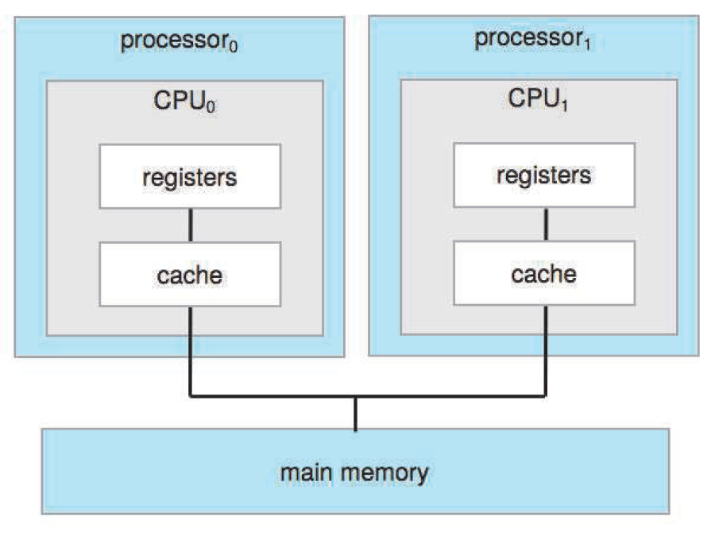
Multiple CPUs

Slide 38
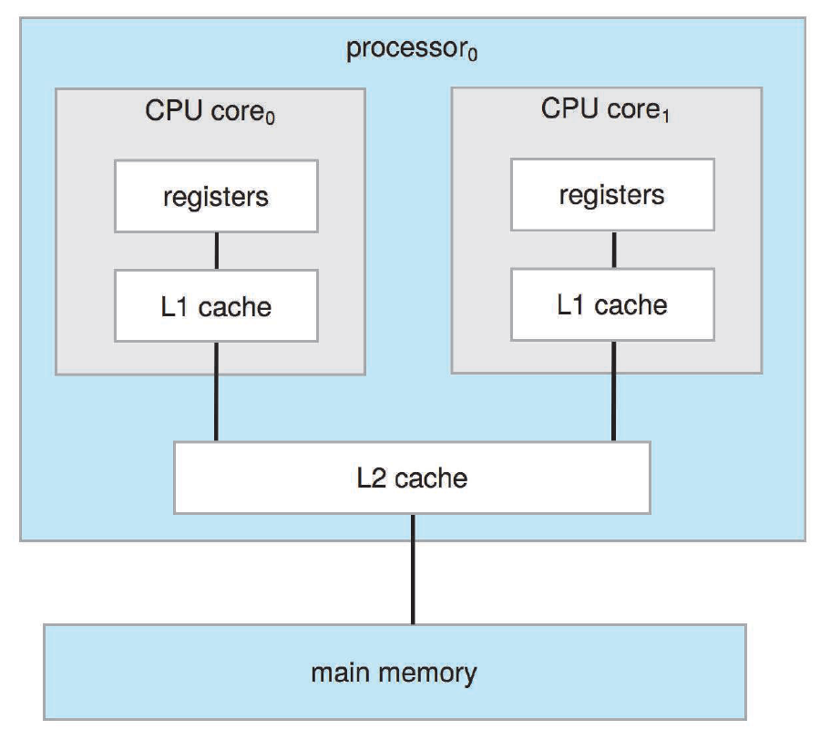
Multiple Cores

Slide 39
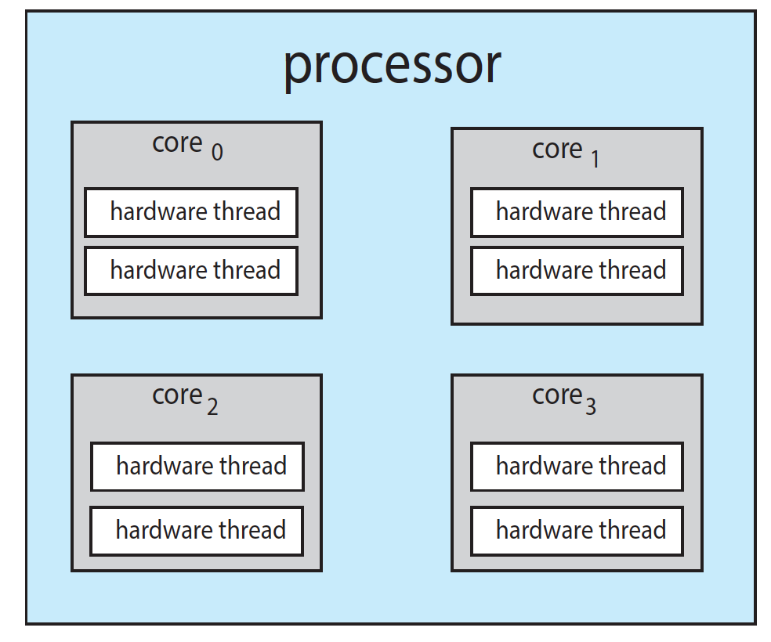
Hardware Threads

Slide 40
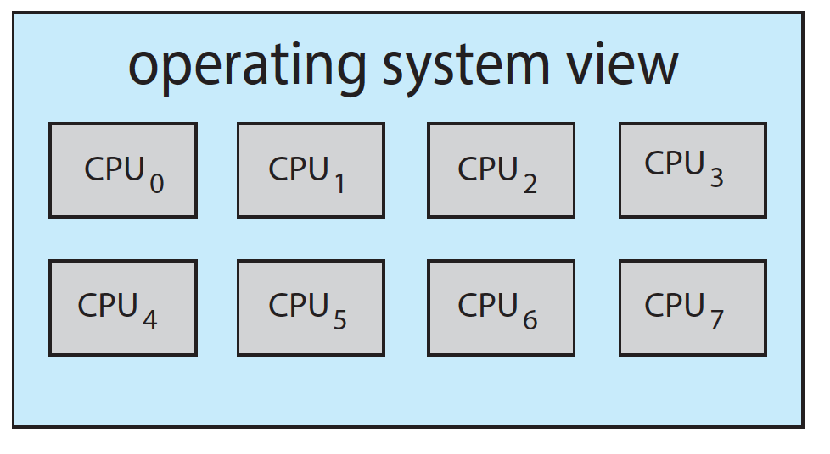
Logical CPUs

Slide 41
Multiple-Processor Scheduling
CPU scheduling more complex when multiple CPUs are available
Asymmetric multiprocessing – only one processor accesses the system data structures, alleviating the need for data sharing
Symmetric multiprocessing (SMP) – each processor is self-scheduling, all processes in common ready queue, or each has its own private queue of ready processes
Currently, most common
Notes:
每个处理器都检查共同的就绪队列

Slide 42
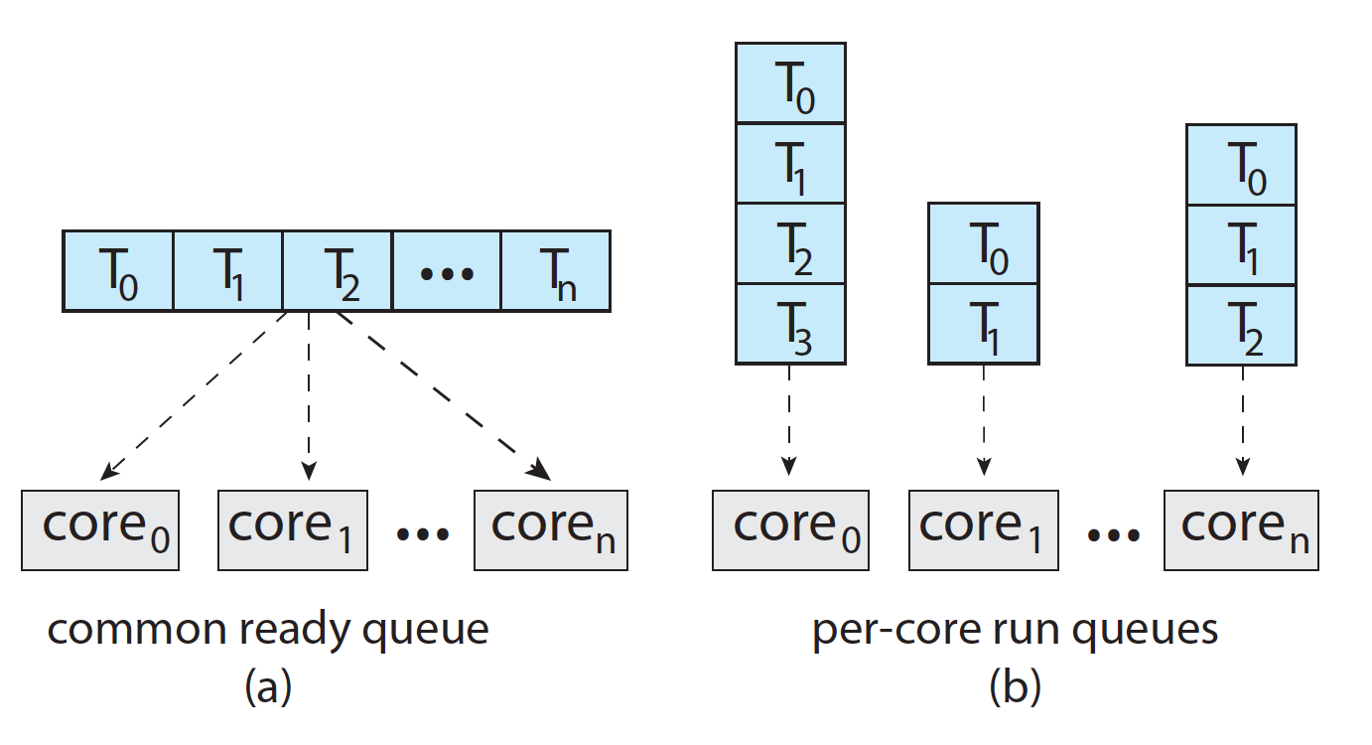
Ready Queue for Multiprocessor
Notes:
多处理器共享
每个处理器有自己的ready queue

Slide 43
Processor Affinity
Processor affinity – process has affinity for processor on which it is currently running
soft affinity： OS 试图保持进程运行在某一处理器，但不保证不会切换
hard affinity： 允许某进程运行在某个处理器子集上。

Slide 44
Hard Affinity
Bound thread to CPU
API
sched_setaffinity()
Demo
Notes:
软亲和性（affinity) Linux 内核进程调度器天生就具有被称为软 CPU 亲和性（affinity）的特性，这意味着进程通常不会在处理器之间频繁迁移。这种状态正是我们希望的，因为进程迁移的频率小就意味着产生的负载小。
硬亲和性（affinity）： 就是利用linux内核提供给用户的API，强行将进程或者线程绑定到某一个指定的cpu核运行。
需要绑定CPU的原因：

Slide 45
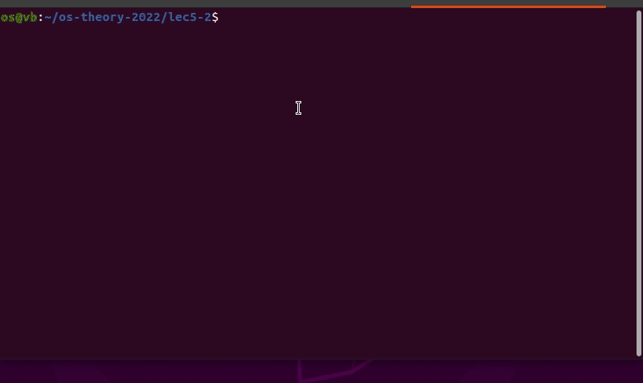
Linux Processor Affinity
Notes:
1.提高cache命中率；
2.在一些非对称CPU，比如NUMA中，防止一个CPU去另外一个插槽的内存读写数据；
top 按 1: 查看所有核
top 按 H: 查看线程
top -p PID: 查看某一特定进程（top -p pid1 -p pid2）
top: 按f设置显示列，按空格选定P查看运行核，q退出
更多方法见：https://blog.csdn.net/ibless/article/details/82431101
cat /proc/cpuinfo
lscpu
一定 sudo 执行：sched_setaffinity( )

Slide 46
Load Balancing（负载均衡）
If SMP, need to keep all CPUs loaded for efficiency
Load balancing attempts to keep workload evenly distributed
Push migration(迁移) – periodic（周期性地） task checks load on each processor, and if found pushes task from overloaded CPU to other CPUs
Passive
Pull migration – idle processors pulls waiting task from busy processor
Active (idle processor)
Counteracts（抵消） the benefits of processor affinity
Notes:
普通任务：
周期性负载均衡，在时钟tick会检查哪个核空闲，优先使空闲核工作(从负载重的核pull任务，或push任务给空闲核，每个CPU以劳动为乐)；
idle时负载均衡；某个核进入idle状态，会主动pull任务执行；
fork和exec时负载均衡；创建的新进程，会放到最闲的核去跑；

Slide 47
Non-uniform Memory Access

Slide 48
NUMA and CPU Scheduling
Note that memory-placement algorithms can also consider affinity
Notes:
Memory affinity
进程对处理器的affinity可以这样实现

Slide 49
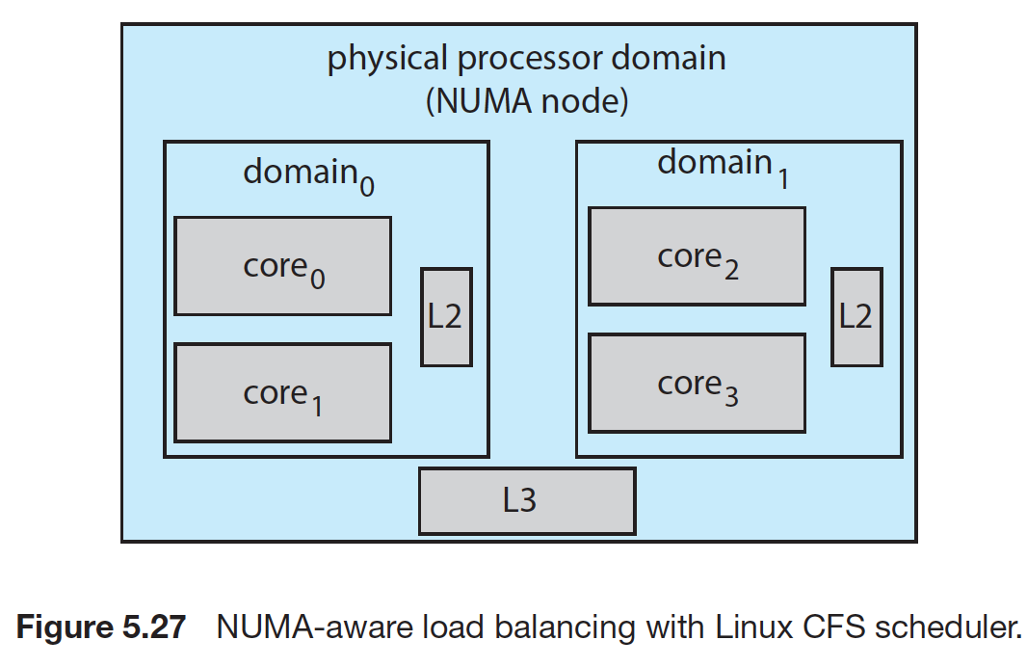
Linux Load Balancing

Slide 50
Heterogeneous Multiprocessing

Slide 51
Heterogenous（异构） Multi-Processing
big.LITTLE where higher-performance big cores are combined with energy efficient LITTLE cores
a CPU scheduler can assign tasks that do not require high performance, but may need to run for longer periods, (such as background tasks) to little cores
Additionally, if the mobile device is in a power-saving mode, energy-intensive big cores can be disabled and the system can rely solely on energy-efficient little

Slide 52
Real Time CPU Scheduling

Slide 53
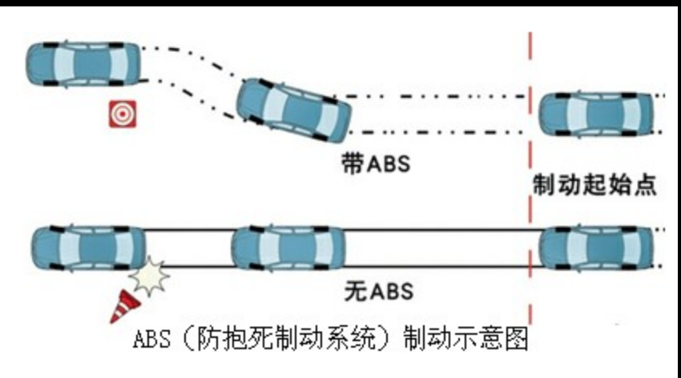
Antilock
Antilock brake system（ABS） might be 3 to 5 milliseconds. That is, from the time a wheel first detects that it is sliding, the system controlling the antilock brakes has 3 to 5milliseconds to respond to and control.

Slide 54
Real-Time CPU Scheduling
Can present obvious challenges
Soft real-time systems – no guarantee as to when critical（关键的） real-time process will be scheduled
Hard real-time systems – task must be serviced by its deadline
Two types of latencies affect performance (event latency)
Interrupt latency – time from arrival of interrupt to start of routine that services interrupt
Dispatch latency（调度延迟） – time for schedule to take current process off CPU and switch to another
Notes:
Event latency 包含 interrupt latency and dispatch latency

Slide 55
Interrupt Latency

Slide 56
Dispatch Latency
Notes:
前面讲dispatcher的时候讲了

Slide 57
Real-Time CPU Scheduling (Cont.)
Conflict phase of dispatch latency:
Preemption of any process running in kernel mode
Release by low-priority process of resources needed by high-priority processes
Notes:
Red line deadline

Slide 58
Priority-based Scheduling
For real-time scheduling, scheduler must support preemptive, priority-based scheduling
But only guarantees soft real-time
For hard real-time must also provide ability to meet deadlines

Slide 59
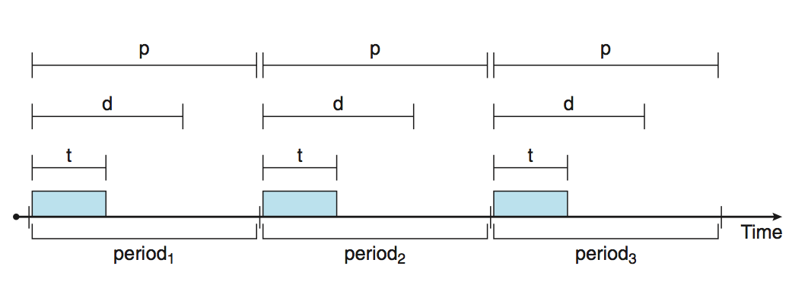
Priority-based Scheduling
Processes have new characteristics: periodic（周期性的） ones require CPU at constant intervals
Has processing time t, deadline d, period（周期） p
0 ≤ t ≤ d ≤ p （usually d=p, that is, deadline is next time）
Rate of periodic task is 1/p
Notes:
进程是周期性的，定期需要占用CPU

Slide 60
Rate Monotonic（单调速率） Scheduling
A priority is assigned based on the inverse（反比） of its period
Shorter periods = higher priority
Longer periods = lower priority
preemptive
 | period | execution time
P1 | 50 | 20
P2 | 100 | 35
deadline＝period
Notes:
优先级高的固定执行，低的只能在其空闲执行

Slide 61
Rate Montonic Scheduling
 | period | execution time
P1 | 50 | 20
P2 | 100 | 35
 | P1
 | P2
0 | 10 | 20 | 30 | 40 | 50 | 60 | 70 | 80 | 90 | 100 | 110 | 120 | 130 | 140 | 150 | 160 | 170 | 180 | 190
Notes:
P1的period短，所以设置p1优先级大于p2，p1执行完后p2才可以执行；p1可以抢占p2

Slide 62
Missed Deadlines with RM
 | period | execution time
P1 | 50 | 25
P2 | 80 | 35
 | P1
 | P2
Deadline = period
0 | 10 | 20 | 30 | 40 | 50 | 60 | 70 | 80 | 90 | 100 | 110 | 120 | 130 | 140 | 150 | 160 | 170 | 180 | 190
Notes:
超过了p2的deadline

Slide 63
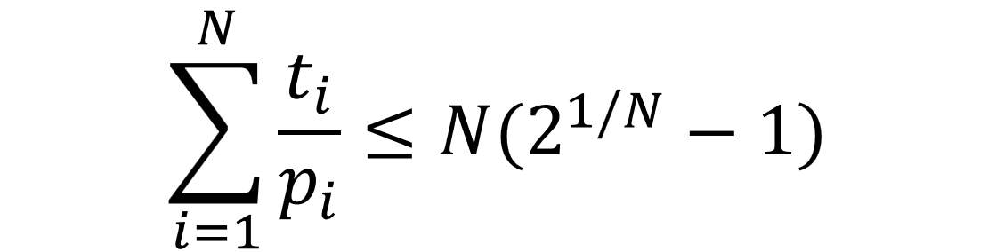
RM Schedulability Test: sufficient
 | period | execution time
P1 | 50 | 20
P2 | 100 | 35
 | period | execution time
P1 | 50 | 25
P2 | 80 | 35
N: number of processes
t_{i}: processing time
p_{i}: period

Slide 64
Earliest Deadline First

Slide 65
Earliest Deadline First Scheduling (EDF)最早截止期限优先
Priorities are dynamic assigned according to deadlines:
the earlier the deadline, the higher the priority;
the later the deadline, the lower the priority
 | period | execution time
P1 | 50 | 25
P2 | 80 | 35
Deadline = period
Notes:
Deadline越早，优先级越高
这里的截止期限不是死的25和35，而是系统运行过程中，当一个进程可运行时动态公布的。
看例子

Slide 66
EDF
 | period | execution time
P1 | 50 | 25
P2 | 80 | 35
 | P1
 | P2
0 | 10 | 20 | 30 | 40 | 50 | 60 | 70 | 80 | 90 | 100 | 110 | 120 | 130 | 140 | 150 | 160 | 170 | 180 | 190
Notes:
一开始p1的截止期限为50，p2为80，所以p1的优先级高，先执行，p2等待其执行完。

Slide 67
EDF
 | period | execution time
P1 | 50 | 25
P2 | 80 | 35
 | P1
 | P2
0 | 10 | 20 | 30 | 40 | 50 | 60 | 70 | 80 | 90 | 100 | 110 | 120 | 130 | 140 | 150 | 160 | 170 | 180 | 190
Notes:
轮到p2开始执行。

Slide 68
EDF
 | period | execution time
P1 | 50 | 25
P2 | 80 | 35
 | P1
 | P2
0 | 10 | 20 | 30 | 40 | 50 | 60 | 70 | 80 | 90 | 100 | 110 | 120 | 130 | 140 | 150 | 160 | 170 | 180 | 190
Notes:
这里到达p1的下一个周期，
此时还在执行的的p2不会像rate monotonic一样被p1抢占，
因为P1执行完毕后，p1的截止期限更新为为100，p2还是80，p2的优先级高。

Slide 69
EDF
 | period | execution time
P1 | 50 | 25
P2 | 80 | 35
 | P1
 | P2
0 | 10 | 20 | 30 | 40 | 50 | 60 | 70 | 80 | 90 | 100 | 110 | 120 | 130 | 140 | 150 | 160 | 170 | 180 | 190
Notes:
p2结束轮到p1开始执行

Slide 70
EDF
 | period | execution time
P1 | 50 | 25
P2 | 80 | 35
 | P1
 | P2
0 | 10 | 20 | 30 | 40 | 50 | 60 | 70 | 80 | 90 | 100 | 110 | 120 | 130 | 140 | 150 | 160 | 170 | 180 | 190
Notes:
这里到达p2的下一个周期，
P1还没有执行完，但是不会像rate monotonic被p2抢占，
因为P2执行完后，p2的deadline更新为160，p1还是100，现在p1优先级高。

Slide 71
EDF
 | period | execution time
P1 | 50 | 25
P2 | 80 | 35
 | P1
 | P2
0 | 10 | 20 | 30 | 40 | 50 | 60 | 70 | 80 | 90 | 100 | 110 | 120 | 130 | 140 | 150 | 160 | 170 | 180 | 190
Notes:
轮到p2执行

Slide 72
EDF
 | period | execution time
P1 | 50 | 25
P2 | 80 | 35
 | P1
 | P2
0 | 10 | 20 | 30 | 40 | 50 | 60 | 70 | 80 | 90 | 100 | 110 | 120 | 130 | 140 | 150 | 160 | 170 | 180 | 190
Notes:
到了100，p1开始下一个周期，直接抢占p2开始执行
因为P1截止期限为150，p2还是160，p1优先级高，
所以被抢占了。

Slide 73
EDF
 | period | execution time
P1 | 50 | 25
P2 | 80 | 35
 | P1
 | P2
0 | 10 | 20 | 30 | 40 | 50 | 60 | 70 | 80 | 90 | 100 | 110 | 120 | 130 | 140 | 150 | 160 | 170 | 180 | 190
Notes:
P1执行完后，截止期限改为200，p2截止期限还是160（这里没有用到抢占，只是顺带一提）
p2等到cpu，执行完刚才没执行的部分。

Slide 74

EDF Schedulability Test: iff
 | period | execution time
P1 | 50 | 25
P2 | 80 | 35
N: number of processes
t_{i}: processing time
p_{i}: period
Notes:
CPU利用率
执行时间之和/周期之和

Slide 75
End of Chapter 5

